Slide 1



Rental bike prediction
By- DIPTIRTha chatterjee, Dhiraj kumar, shilendra nath Yadav
Dst-cims bhu

Slide 2

Purpose
Extensive Start-up idea
Add value to the business
Few research papers

Slide 3

Why to rent A bike?
Getting a bike on rent saves you from worrying about what you're going to have to do with your existing bike if and when you decide to upgrade.
You also get access to the latest makes and models, and every bike rental provider will be able to help you choose the perfect bike for you.
If there is one thing you need to explore the places, is on the bicycle. ... When you go to the office or to buy groceries, use the bicycle as a commute. It is the easiest and safest commute to avoid traffic. For any kind of work where you have to go out, you can rent a bicycle

Slide 4

What we can do?
There are several Machine Learning Algorithm which can be used to detect the count of bike efficiently to fulfil the demand. We have used some of them in this project. They are –
Linear Regression
Polynomial Regression
Decision tree Regression
Random Forest Regression
Stacking Regression

Slide 5
Dataset description
Currently Rental bikes are introduced in many urban cities for the enhancement of mobility comfort.
It is important to make the rental bike available and accessible to the public at the right time as it lessens the waiting time. Eventually, providing the city with a stable supply of rental bikes becomes a major concern. The crucial part is the prediction of bike count required at each hour for the stable supply
of rental bikes.
The dataset contains weather information (Temperature, Humidity, Windspeed, Visibility, Dewpoint, Solar radiation, Snowfall, Rainfall), the number of bikes rented per hour and date information.
Data Source :http://data.seoul.go.kr/
SOUTH KOREA PUBLIC HOLIDAYS. URL: publicholidays.go.kr

Slide 6
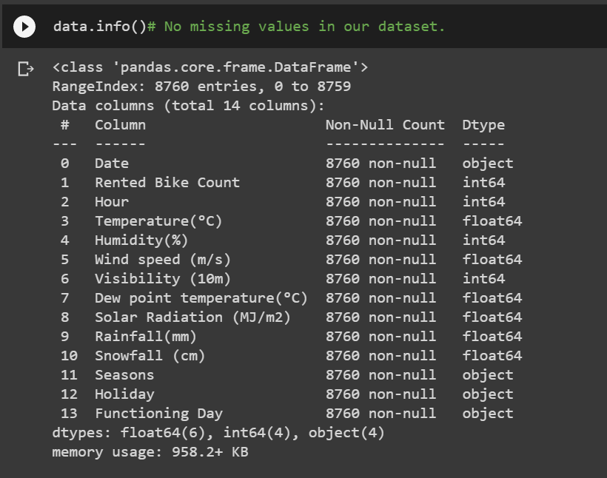
Dataset analysis
Our dataset have no missing values.

Slide 7
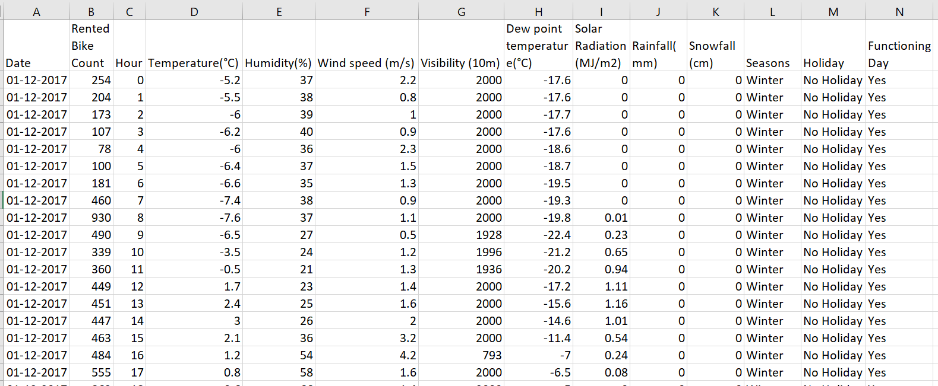
Dataset View

Slide 8
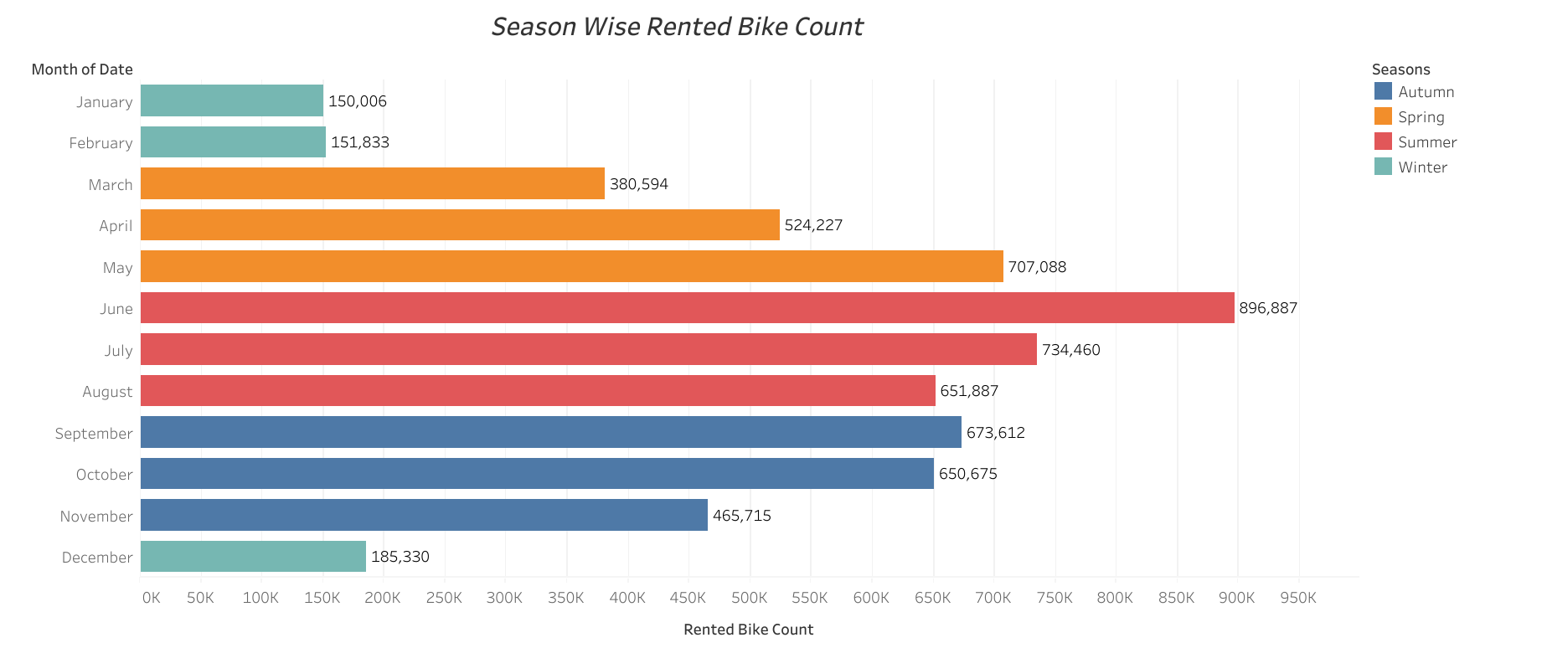
Exploratory Data analysis

Slide 9
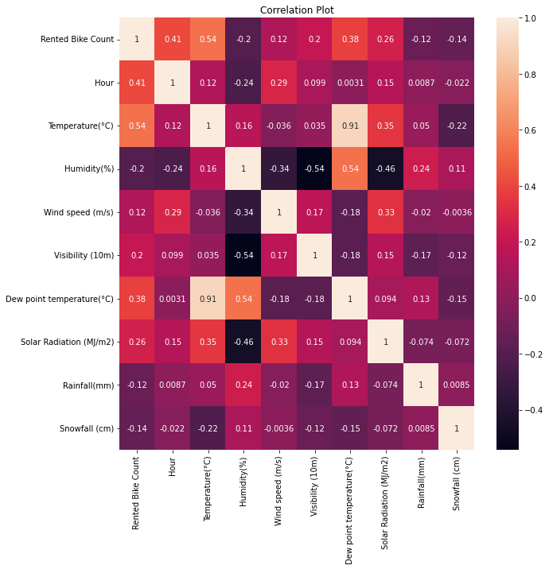

Slide 10
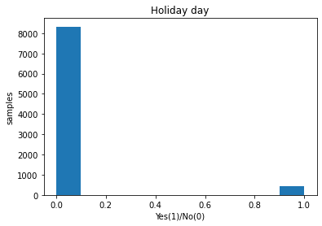
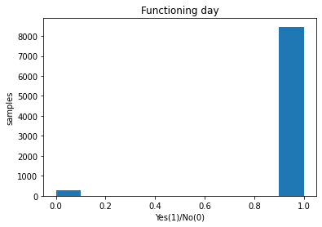
Exploratory Data analysis

Slide 11
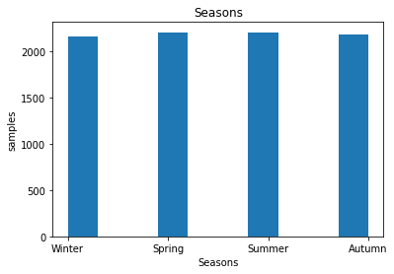
Sampling technique

Slide 12
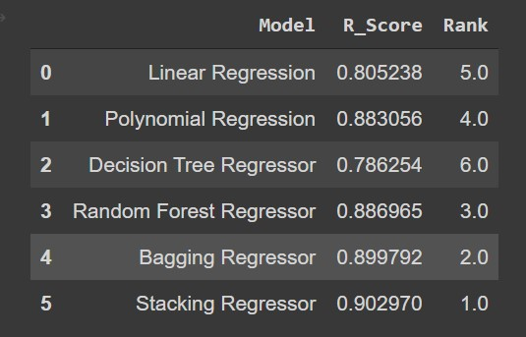
Accuracy Score Comparison
We have got 90.29% accuracy by Staking Regression so far from our research.
That’s not the END!
We will dig deeper to predict accurately to fulfil customer’s demand efficiently.

Slide 13
Future Enhancement
We will use Ridge and lasso regression to see if they can fit the data better than others.
We will us 10-fold cross validation in future.
More data always increases the precision of any algorithm. We will also try to predict this problem with more data. However, this needs some official supports from firms to face the real-life data problems.

Slide 14
What’s new?
We have found 3 research papers published on dataset.
They have used five Statistical regression models with their best hyperparameters using repeated cross-validation and the performance is evaluated using a testing set: (a) Linear Regression (b) Gradient Boosting Machine (c) Support Vector Machine (Radial Basis Function Kernel) (d) Boosted Trees, and (e) Extreme Gradient Boosting Trees. When all the predictors are employed, the best model Gradient Boosting Machine can give the best and highest R² value of 0.96 in the training set and 0.92 in the test set.

Slide 15
References
Sathishkumar V E, Jangwoo Park, and Yongyun Cho. 'Using data mining techniques for bike sharing demand prediction in metropolitan city.' Computer Communications, Vol.153, pp.353-366, March, 2020We will us 10-fold cross validation in future.
Sathishkumar V E and Yongyun Cho. 'A rule-based model for Seoul Bike sharing demand prediction using weather data' European Journal of Remote Sensing, pp. 1-18, Feb, 2020

Slide 16
THANK YOU ALL!
Looking forward for the feedback!☺

